Slide 1
Street Dance
LESSON OBJECTIVES:
Know about three different street dance techniques
Learn how to use them
Understand how to improve on them
Include them in our class dance
To evaluate and review our progress so far with a log sheet

Slide 2
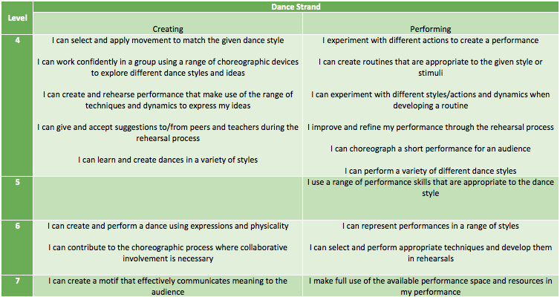
Success Criteria

Slide 3
Warm up GROUP 1 TO LEAD THIS WEEKS WARM UP.

Slide 4
Street Dance technique 1
The Uprock
Originally performed to warm up or prepare before performing a break move
People personalise their uprock to gain their own personal style or tag.
https://www.youtube.com/watch?v=B_hSXH7oJnk

Slide 5
Street Dance technique 3
The Jerk
Invented in L.A
It involves moving your legs out at jerky angles and includes moves such as ‘reject’ ‘dip’ and ‘pin drop’
https://www.youtube.com/watch?v=fnsPoP7JNg8

Slide 6
Street Dance technique 2
The Dougie
Invented by 1980’s American rapper Doug E. Fresh
Dance crew/singers Cali Swag district have made it popular in recent years
https://www.youtube.com/watch?v=4EIl1qh9lqU

Slide 7
What could we do to improve our uprock, dougie and jerk?

Slide 8
Lets Dance!
Recap last weeks choreography
Peer assess
Create new material
Cool down
Log sheets

Slide 9
CREATIVITY
Recap the movement material you created last week in your small groups.
Choreograph the next 2 counts of 8 adding in:
The Jerk
The Dougie
The Uprock
REHEARSE ALL OF THE MOVEMENT JOINED TOGETHER.

Slide 10
Plenary
What have you enjoyed?
What have you found challenging?
What have you learnt?
How have you progressed?
What can you improve on next time?
Well done!

